Slide 1
Crimson Syndicate Drum Co
The purpose of this website is to sell drums to customers. We specialize in wood stain drum finishes. Customers can choose the make of their drum shell, the size of their drums, wood stain color and hardware.

Slide 2
HOME
FIND YOUR SOUND
DRUM SIZES
WOOD STAINS
HARDWARE
ORDER TODAY!

Slide 3
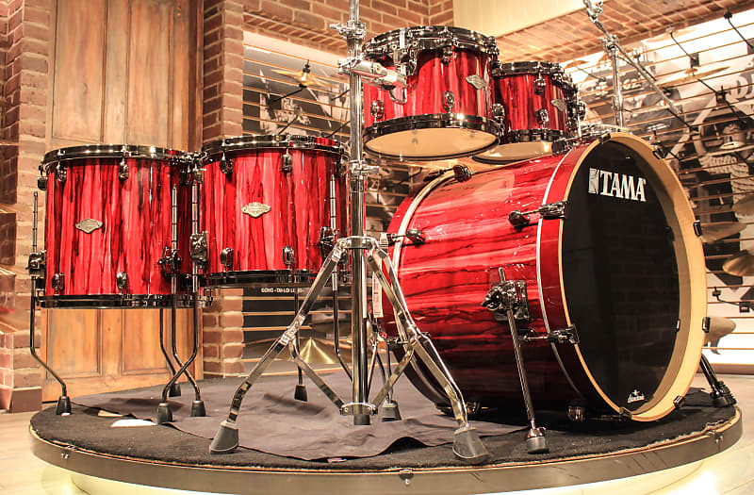
CRIMSON SYNDICATE DRUM CO
HOME
FIND YOUR SOUND
DRUM SIZES
WOOD STAINS
HARDWARE
ORDER TODAY!
At Crimson Syndicate Drum Co., we specialize in custom wood finishes. We believe in letting the drums breathe so they can sign. Say goodbye to wraps that warp. Let the beauty of the wood shine with a wood stain finish. Select your drum shell, size, hardware and stain color and we will get you ready to play!
Crimson Syndicate Drum Co.
2433 W Main St Mesa, AZ 85201
602-565-7748
NICDW28561@maricopa.edu

Slide 4

CRIMSON SYNDICATE DRUM CO
HOME
FIND YOUR SOUND
DRUM SIZES
WOOD STAINS
HARDWARE
ORDER TODAY!
Finding your sound is just as important as finding your look.
Drum shells come in a variety of wood types like maple, ash, oak. Choose yours for the right sound today.
Maple: All purpose. Even amount of high and mid tones.
Birch: Loud and cutting. High frequencies, reduced mid-range, good low end punch.
Mahogany: Vibrant and resonant. Muted highs, smooth midrange, rich low end.
Ash: Throaty and warm. Pronounced warm highs and mids, average low end.
Oak: All purpose. Soft highs, good midrange, warm lows.
Walnut: Big and warm. Equal highs, mids, and lows.
Crimson Syndicate Drum Co.
2433 W Main St Mesa, AZ 85201
602-565-7748
NICDW28561@maricopa.edu

Slide 5
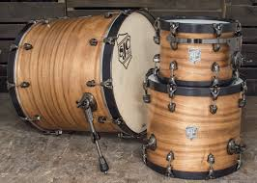
CRIMSON SYNDICATE DRUM CO
HOME
FIND YOUR SOUND
DRUM SIZES
WOOD STAINS
HARDWARE
ORDER TODAY!
Drums come in a variety of sizes to choose from, each with their own unique sound. Here at Crimson Syndicate we offer the standard array, plus a few extras with some punch.
Bass Drum | Size | Floor Toms | Size
The Standard | 20”x16” | The Standard | 14”x14”
The Punch | 22”x16” | Loud & Proud | 16”x16”
The Bonham | 26”x14” | Some Extra Bass | 18”x18”
Rack Toms | Size | Snare Drum | Size
The Standard A | 10”x8” | Snap | 14”x5.5”
The Hawk | 12”x12” | Crackle | 14”x8”
The Vinnie | 14”x14” | Pop | 14”x10”
Crimson Syndicate Drum Co.
2433 W Main St Mesa, AZ 85201
602-565-7748
NICDW28561@maricopa.edu

Slide 6
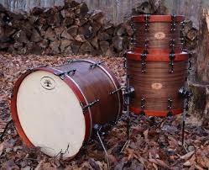
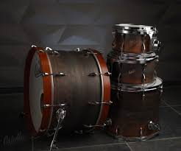
CRIMSON SYNDICATE DRUM CO
HOME
FIND YOUR SOUND
DRUM SIZES
WOOD STAINS
HARDWARE
ORDER TODAY!
Wood Stain Process
Drum shells cleaned and wiped down with microfiber cloths to remove any particles
1 coat of pre-stain sealer
3 coats of wood-stain of your choice applied
2 coats of stain protector to lock in your stain
We offer a wide variety of wood stain colors for you to choose from. Order yours today!
Crimson Syndicate Drum Co.
2433 W Main St Mesa, AZ 85201
602-565-7748
NICDW28561@maricopa.edu

Slide 7
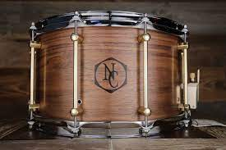



CRIMSON SYNDICATE DRUM CO
HOME
FIND YOUR SOUND
DRUM SIZES
WOOD STAINS
HARDWARE
ORDER TODAY!
No drum or drum set is complete without the right hardware. Choose from black, brass, or chrome finish for your hoops and lugs.
Currently we offer tube, single point and single point double end lugs.
Drum Lugs
Tube
Single Point
Single Point Double End
Crimson Syndicate Drum Co.
2433 W Main St Mesa, AZ 85201
602-565-7748
NICDW28561@maricopa.edu

Slide 8
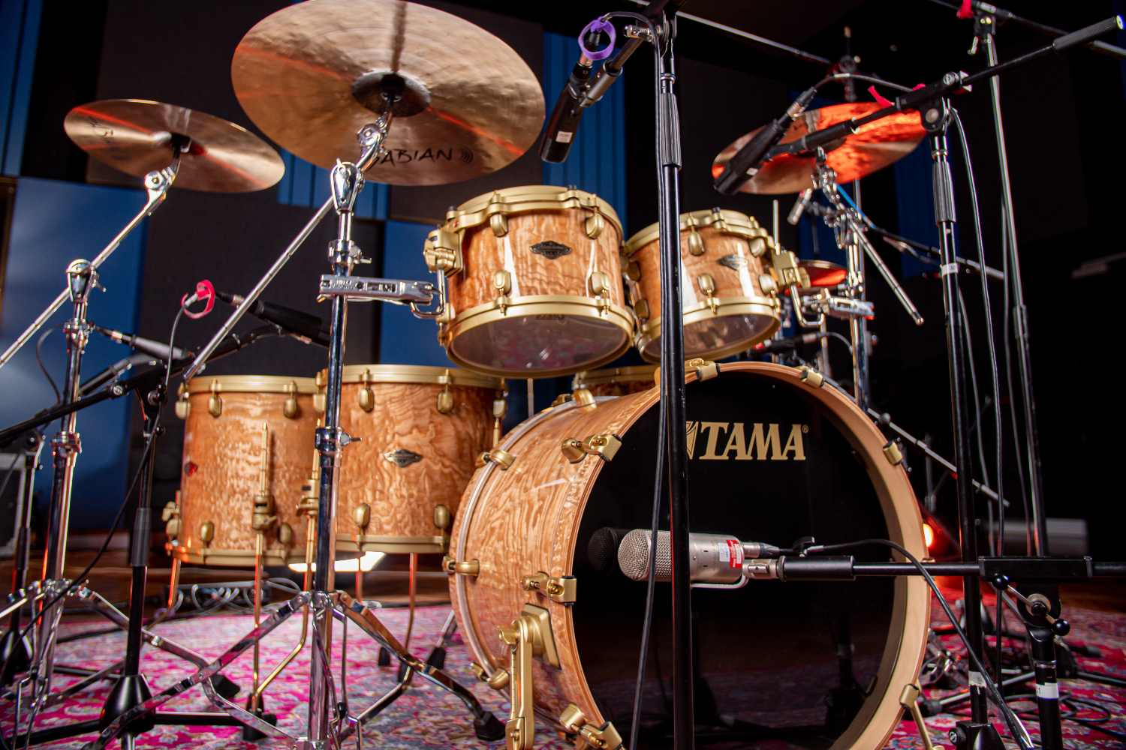
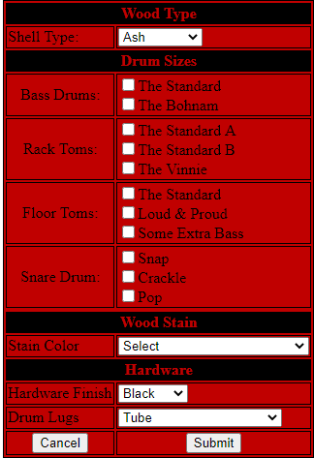
CRIMSON SYNDICATE DRUM CO
HOME
FIND YOUR SOUND
DRUM SIZES
WOOD STAINS
HARDWARE
ORDER TODAY!
Crimson Syndicate Drum Co.
2433 W Main St Mesa, AZ 85201
602-565-7748
NICDW28561@maricopa.edu

